Slide 1
Automated Detection of Leukemia Using Artificial Intelligence
Luca Jordano, Josh Paik, Hannah Sheats

Slide 2
Chronic Lymphocytic Leukemia
3800 new cases per year in UK
Amongst top 20 cancers in the UK
Highest in people aged 85-89
About 990 deaths per year in the UK and 3930 deaths worldwide.
This is a prime candidate for automation as diagnostic techniques involve time consuming manual labor.

Slide 3
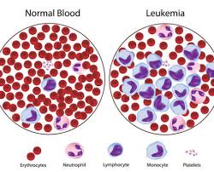
Chronic Lymphocytic Leukemia
Diagnosed by counting white blood cells
The average human has below 1% ratio of white to red blood cell.
If the ratio is above 5% then Lymphocytosis likely
If lymphocytes count is above 15% it is highly likely the patient has CLL
Leukocytes can be stained using anti CD83, anti CD5 or Wright's stain.

Slide 4
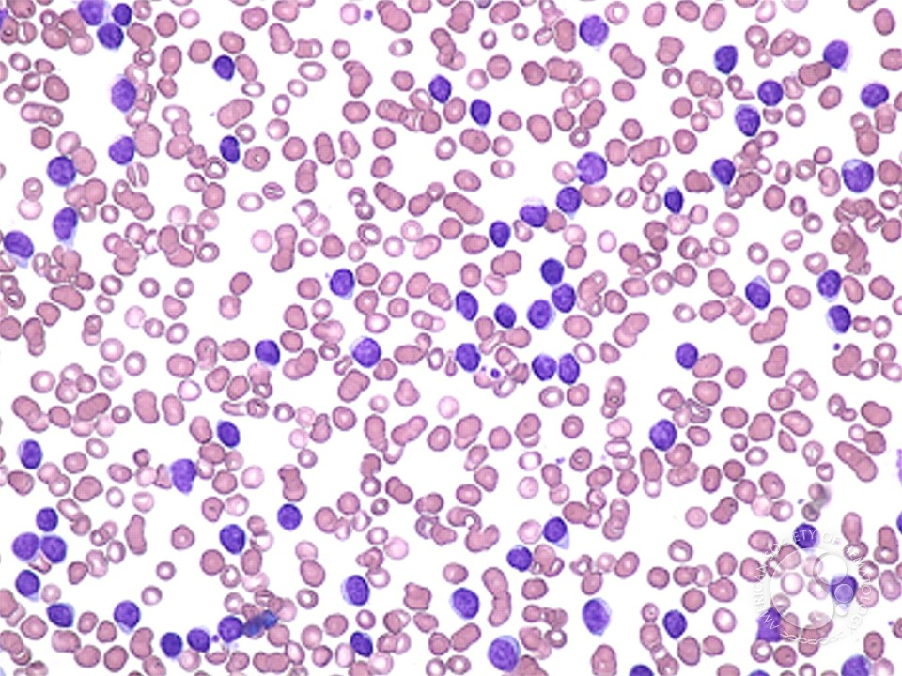
AI Pipeline
Segment the image into individual cell crops. Count the number of crops (n_cells).
Classify each crop as a white blood cell or not. Count the number of white blood cells (n_white_cells).
Determine the proportion of white blood cells as
P = n_white_cells/n_cells.
If P > 15%, diagnose as leukemia.

Slide 5
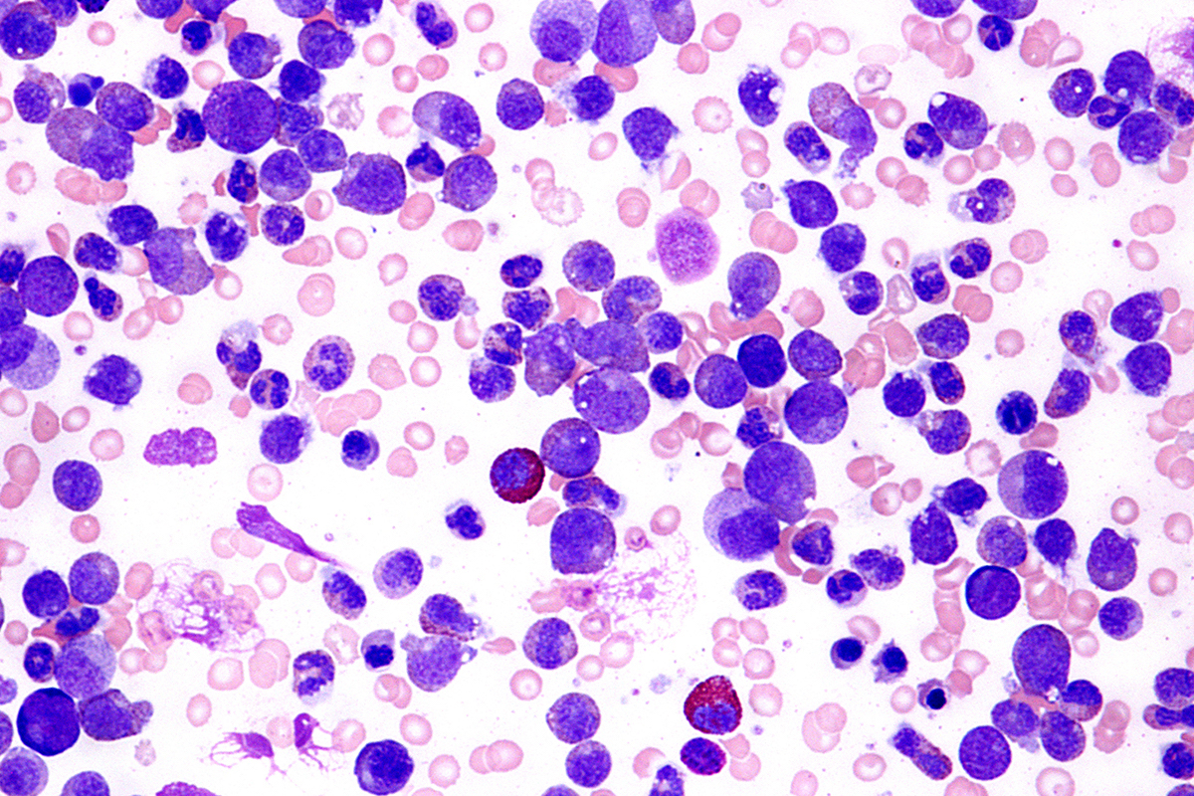
Image Classification
Per image staining technique, red blood cells are “pink”, while white blood cells are “purple”. Can naively determine by considering area under curve

Slide 6
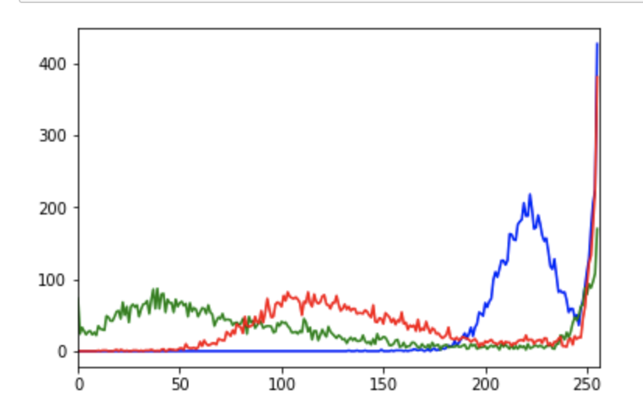
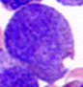
White Blood Cell

Slide 7

White Blood Cell

Slide 8
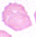
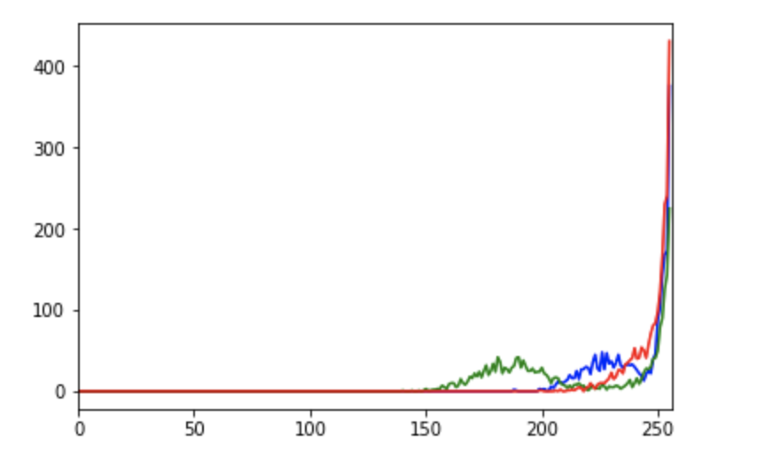
Red Blood Cell

Slide 9
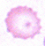
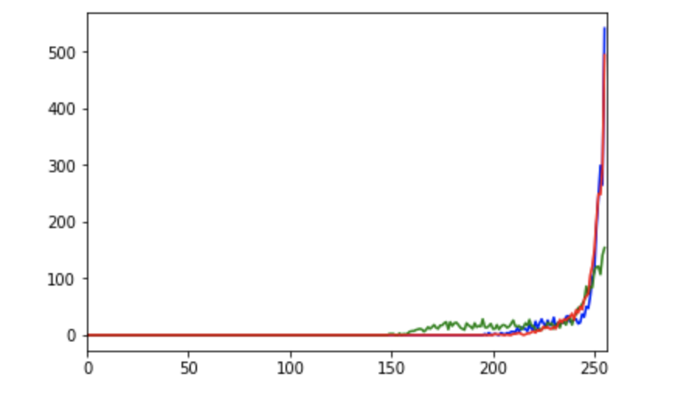
Red Blood Cell

Slide 10
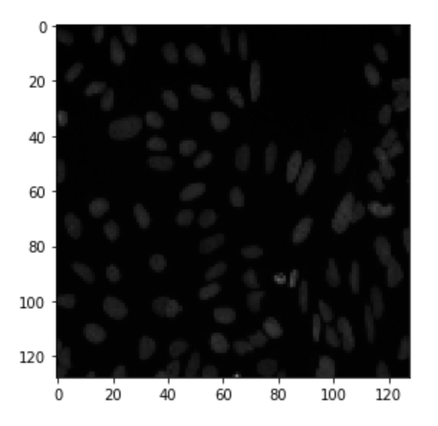
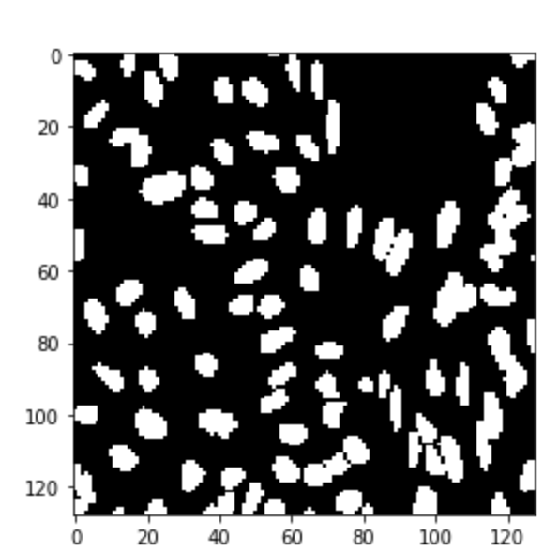
Image segmentation
UNET or Mask-RCNN are the two obvious candidates.

Slide 11
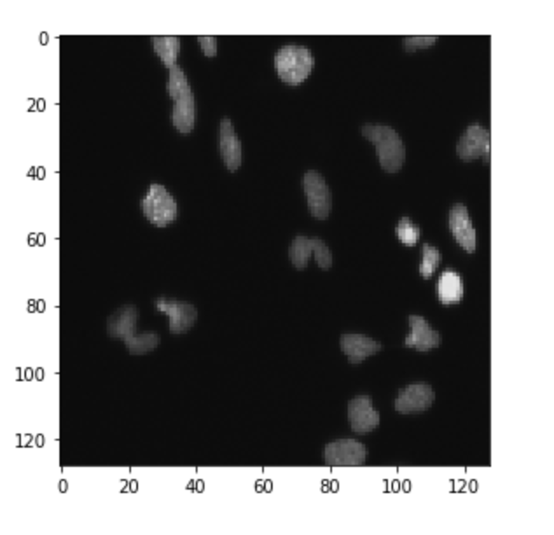
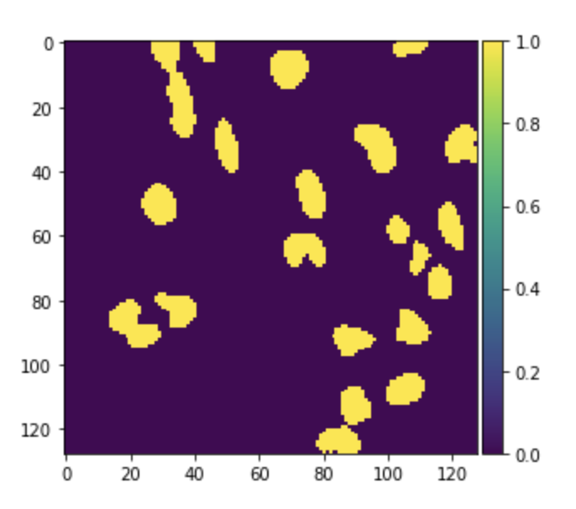
Good mask of UNET

Slide 12
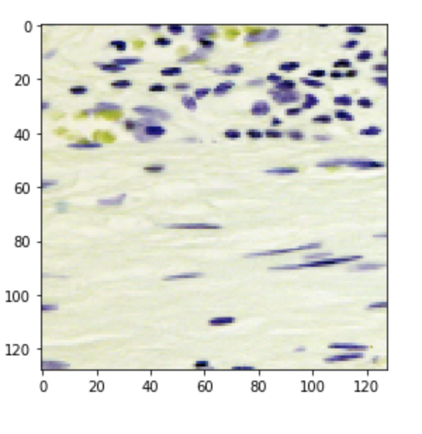
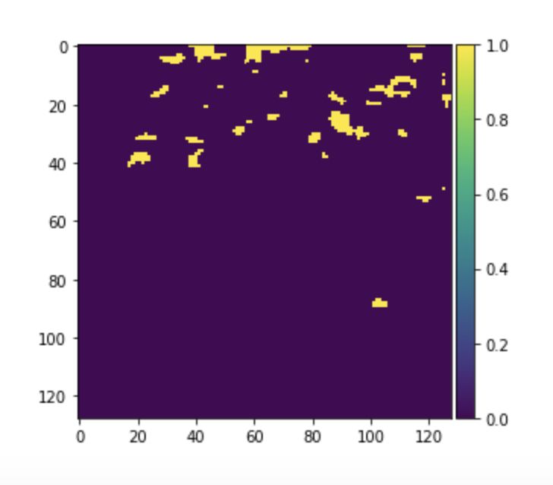
Bad Masks of UNET

Slide 13
Data Collection
More data = better performance.
Would be nice to have 60,000 images.
Costs approximately £180,000 for labelling.
Costs for acquiring images ~£60,000

Slide 14
Business Model
Estimated expenses at £500,000
Software as a Service (SaaS)
1,257 hospitals in the UK.
£5,000, per institution per year
£3,142,000 in revenue per annum
Competition: A lot of research, not many companies.
Advanced Cell Classifier - phenotype differences using dyes
Enlitic - radiological ML
None have clinical testing

Slide 15
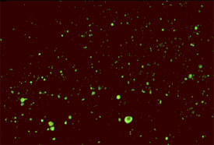
Vision and the Future
Diseases that can be identified through antibody staining or morphology are prime candidate for automation.
If enough data is collected, and the problems defined well enough, then we can address the dearth in pathologists and hemacytologists.

